Slide 1
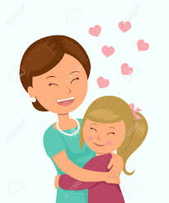
Building Positive Relationships with your Children
A Workshop for
REFRAMING attitudes and statements

Slide 2
Agenda
Introduction of the topic
Hot Button Activity
Challenging Behaviors and their functions
Reframing Activity
Using Positive Statements
Q and A

Slide 3
Examining Attitudes about Challenging Behaviors
HOT BUTTON ACTIVITY:
Group sharing
What pushes your buttons?
How do these behaviors make you feel?
What is your response when these behaviors occur?
How does this impact your relationship with other people?
Notes:
Ask about life outside work then ask about behaviors that children exhibit in school

Slide 4
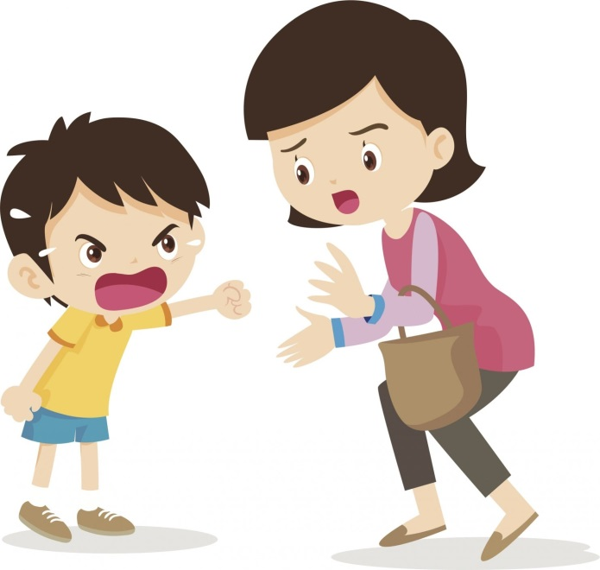
Challenging Behaviors
Screaming
Throwing tantrums
Being verbally aggressive
Throwing objects
Being physically aggressive
What else….?

Slide 5
Challenging Behavior Basic Assumptions
Challenging behavior usually has a message- I am bored, I am sad, you hurt my feelings, I need some attention.
Children often use challenging behavior when they don’t have the social or communication skills they need to engage in more appropriate interactions.
Behavior that persists over time is usually working for the child.
We need to focus on teaching children what to do in place of the challenging behavior (replacement skills)
Notes:
Instead of hitting use words, tap on the shoulder to get attention

Slide 6
Challenging Behavior Works
Children engage in challenging behavior because “it works” for them.
Challenging behavior results in the child gaining access to something or someone (i.e., obtain/request) or avoiding something or someone (i.e., escape/protest).

Slide 7
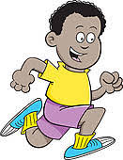
Function of the Behavior
To get attention
To request something e.g., object
To avoid a task (does not want to clean up after playing)
To avoid demands (does not want to do homework)
To express an emotion
To escape sensory overload

Slide 8
Changing Our View
Take the problem away from the child and ask:
Why is this behavior happening?
What changes can I make to prevent the problem from occurring and teach the child new skills?
Notes:
Do some reflection: We need to understand why challenging behaviors happen and what purpose they serve. We then need to implement interventions for these behaviors at an early age that help children learn new behaviors. Develop preventative interventions that are practical and ongoing

Slide 9
Reframing: Thought Control
Problem statement
“I have to watch my child like a hawk or he’ll run down the hall or go out of the door.”
Reframed statement
“He may not understand my expectations. He is very active.”

Slide 10
Reframing: Thought Control
Problem statement
“My daughter constantly knocks over her sister’s toys or destroys them.”
Reframed statement
“She may want to join her sister’s play but doesn’t know how to ask.”

Slide 11
Reframing: Thought Control
Problem statement
“JJ screamed when he wanted a cookie.”
Reframed statement
?
Notes:
JJ doesn’t have the vocabulary or doesn’t know how to request. I must model for him.

Slide 12
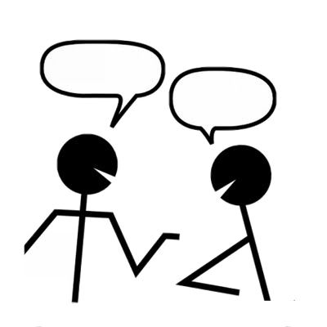
Reframing Activity
In small groups:
Talk about your “hot buttons,” and consider how you can reframe the behavior.
In reframing the challenging behaviors, do not come up with solutions but rather restate the behaviors to make them more manageable.
Be prepared to share your ideas with the large group.
Notes:
Provide an example; see worksheet

Slide 13
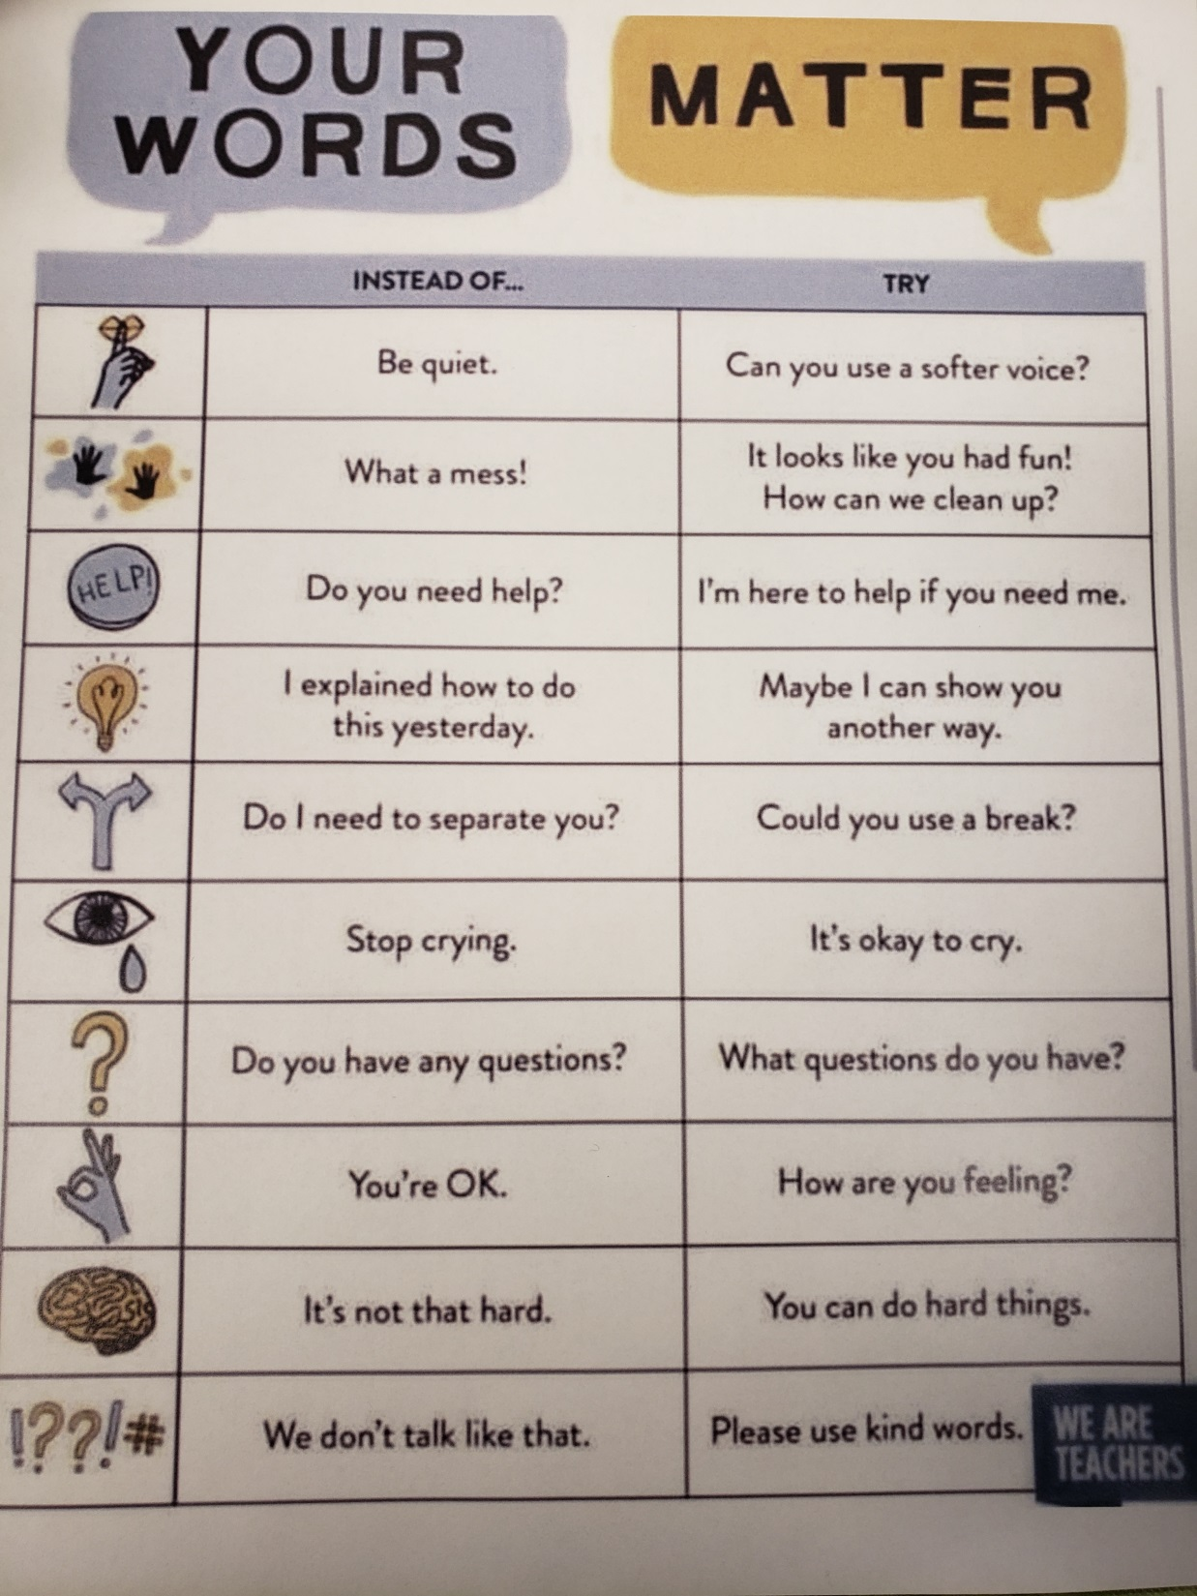

Slide 14
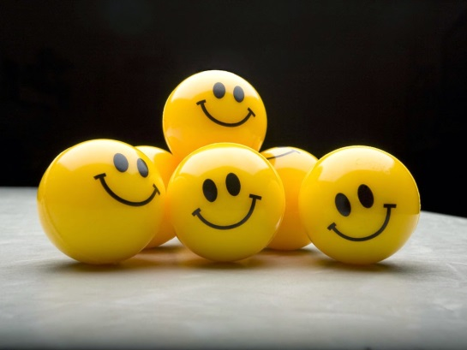
Use Positive Words
Tell the child what to do instead of what not to do.
Clearly and simply state what you expect your child to do.
Have age –appropriate expectations.
Use age-appropriate language.

Slide 15
Examples
Don’t Do
Don’t run! Walk
Don’t hit! Hands down
No coloring on the wall. Color on paper.
No biting! ?
Stop playing with your ?
food.
Stop yelling! ?
Notes:
Refrain from using negative statements.

Slide 16
Building Positive Relationships by Making Deposits
Maintain a 5:1 (positive to negative)
Give attention when the child is engaged in appropriate behaviors

Slide 17
Building relationships: Ideas for Making Deposits
Talk to your child after a difficult day and say, “I’m sorry you had a tough day today. I know tomorrow is going to be better!”
Give hugs, high fives and thumbs up for accomplishing tasks.
Acknowledge children’s efforts.
Give compliments liberally.
Play with children, follow their lead.
Notes:
VALIDATE FEELINGS!

Slide 18
Positive Adult-Child Interactions
Acknowledge child’s communication (verbal or non-verbal)
Engage in one-to-one interactions, at eye level
Use a pleasant, calm voice and simple language
Provide warm, responsive physical contact
Follow the child’s lead and interests during play
Listen to children and encourage them to listen to others
Notes:
Building rapport; child-directed conversation

Slide 19
It All Adds Up
Withdrawals:
No
Don’t
Stop
Demands - directions
Using a loud voice
Intimidating request
Threats
Deposits:
Active Listening
Modeling
Using positive language
Providing verbal praise
Providing hugs, high fives,
thumbs up when they do
something good.

Slide 20
The Benefits!
Influence a child’s emotional, cognitive, and social development
Help children develop secure relationships with other adults
Help children develop good peer relationships
Help reduce the frequency of behavior problems
Help children develop positive self-esteem
Results in higher rates of child engagement
Notes:
ASK BEFORE GOING TO NEXT SLIDE! What can you do to build relationships in the classroom?
What are some ideas for making deposits?

Slide 21
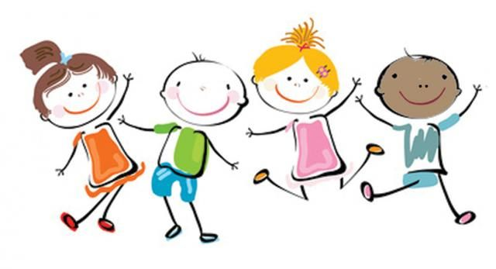
Something to keep in mind….
“When you see a child differently,
you see a different child.”

Slide 22
RESOURCES
http://csefel.vanderbilt.edu/resources/training_preschool.html#mod1
http://challengingbehavior.cbcs.usf.edu/Implementation/family.html
https://www.tolerance.org/magazine/publications/reframing-classroom-management-a-toolkit-for-educators

